Slide 1

Introduction to Data science, Machine learning and Artificial intelligence

Slide 2
Contents
Data science
Types of data/information
Data processing domains
Machine learning
Artificial intelligence

Slide 3
Contents
Need for machine learning
Types of machine learning and workflow of machine learning
Uses cases in machine learning, its various algorithms
What is supervised learning?
What is Unsupervised Learning?

Slide 4
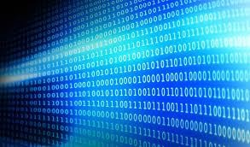
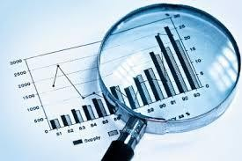

What is Data Science?
Data Science
is the science of analyzing raw data using statistics and machine learning techniques
with the purpose of drawing conclusions about that information
Data Science is used in
many industries to allow them to make better business decisions, and
the sciences to test models or theories

Slide 5

Parts/types of data analytics
Descriptive analytics
Predictive analytics
Prescriptive analytics
Obtaining useful insights from data involves
a process of inspecting, cleaning, transforming (descriptive)
modelling, predicting (predictive) and
recommending actions (prescriptive) from raw measurements

Slide 6
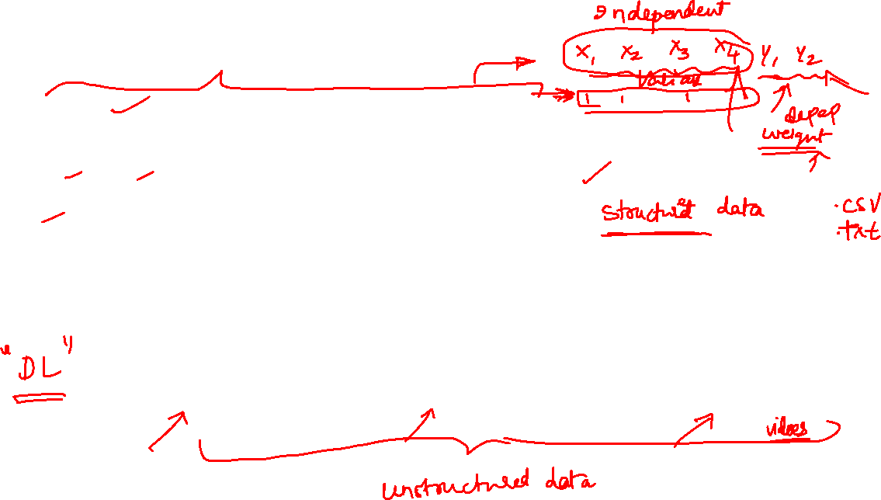
Types of Data/Information
Quantitative
temperature, blood pressure, pulse rate
Categorical
Diabetic/non-diabetic,
Overweight/normal/underweight
Text
Documents (manuals, notes)
Speech
Audio signals
Image
picture (photograph, fingerprint, handwriting)

Slide 7
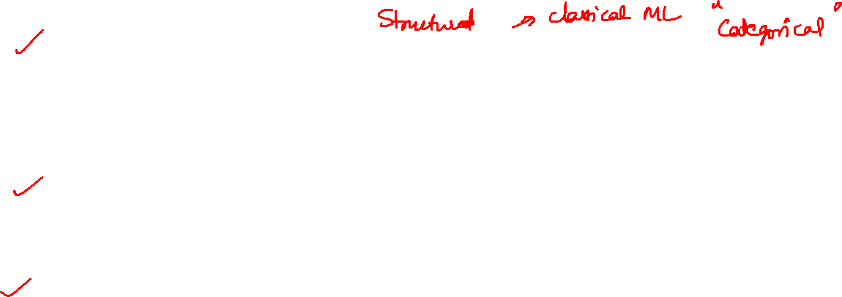
Data processing domains
Quantitative analytics
Processing quantitative data
Computer Vision / Image analysis
Processing image information
Natural Language Processing
Processing textual information

Slide 8
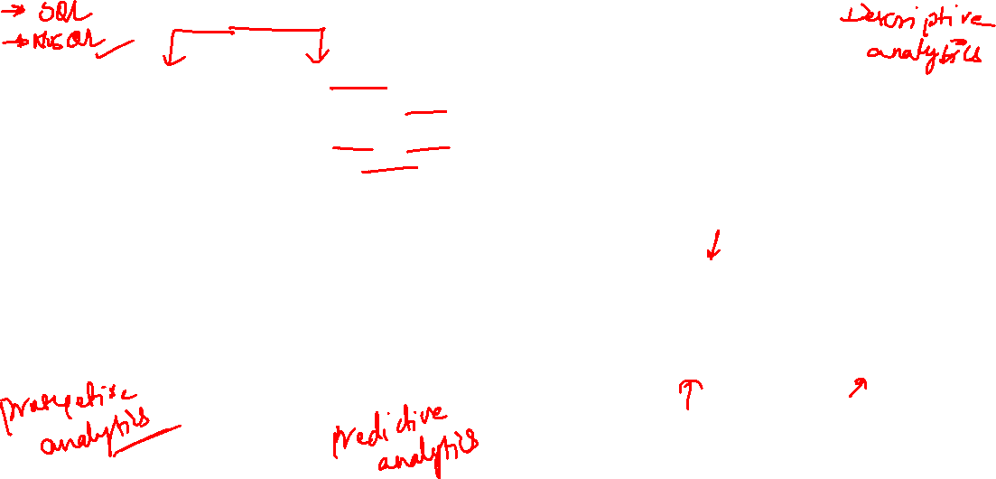
Data analytics workflow
Read data (different storage formats)
Data curating (checking for duplicates, repetitive data, missing data, sufficiency)
Data manipulation
Summarizing data
Visualization
Data cleaning (segmentation, outlier detection)
Build models (check performance, collect more data)
Deriving insights from data & recommend actions

Slide 9

Descriptive analytics
Descriptive analytics deals with
How can you understand the data?
How can you explain the data in a nutshell?
How do you test for the integrity of data? (duplicates, data from different sources merged incorrectly)
How do you find the missing data?
How do you find the outliers?
If the data is multidimensional
how does one bring them to the lower dimensions to get a visual feel of the data?
how can we plot the data to see if there are existing patterns in the data?

Slide 10
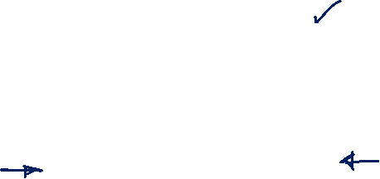
Descriptive analytics
Descriptive analytics deals with
What are the relation between the variables in the data?
Is the data following certain distribution?
All the questions pertaining to descriptive analytics were answered by
Statistics
Inferential analytics
Since the data (sample) is a part of whole data (population)
How well are the inferences made on the sample applicable for the entire population?

Slide 11
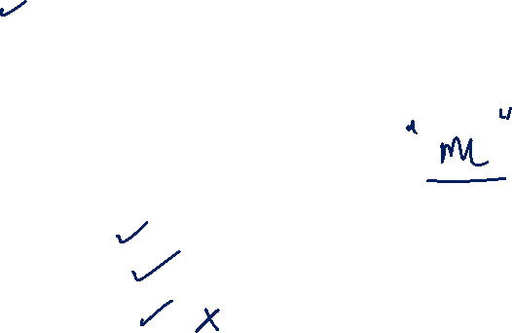
Artificial intelligence
AI is anything capable of mimicking human behavior
Examples:
Siri, Google
a talking doll or
an automated telemarketing call
How could machines achieve them?
Learning
Supervised learning
Unsupervised learning
Reinforcement learning

Slide 12
Artificial intelligence and machine learning
Machines learn from the data that is being presented to them?
Machine learning
Machine learning is a key component for AI to work
So we have ML as an integral part of AI

Slide 13
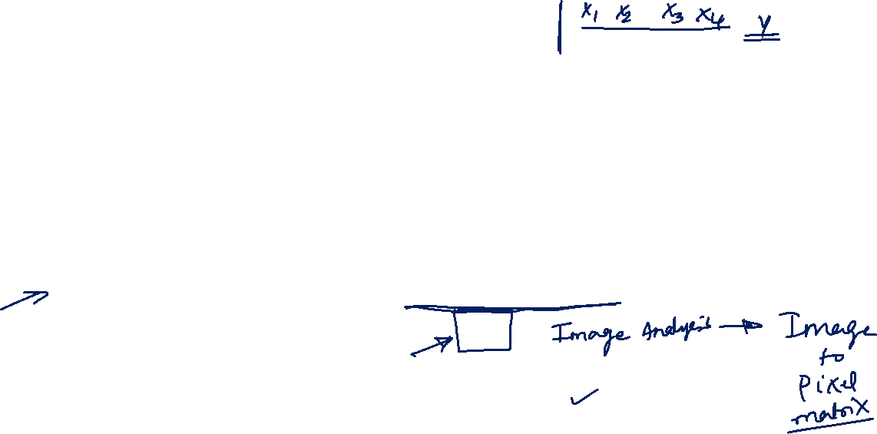
AI, ML and DL –the connection
Depending on how much humans intervene in giving the features to machine to learn from
the classical ML and Deep learning strategies arises
Difference between ML and DL is the following
Features that are to be fed to the machine to learn from are handcrafted by the data scientist in the case of ML
DL on the other hand try to extract the features by it self from the data presented to it
Source: https://www.ibm.com/blogs/systems/ai-machine-learning-and-deep-learning-whats-the-difference/

Slide 14
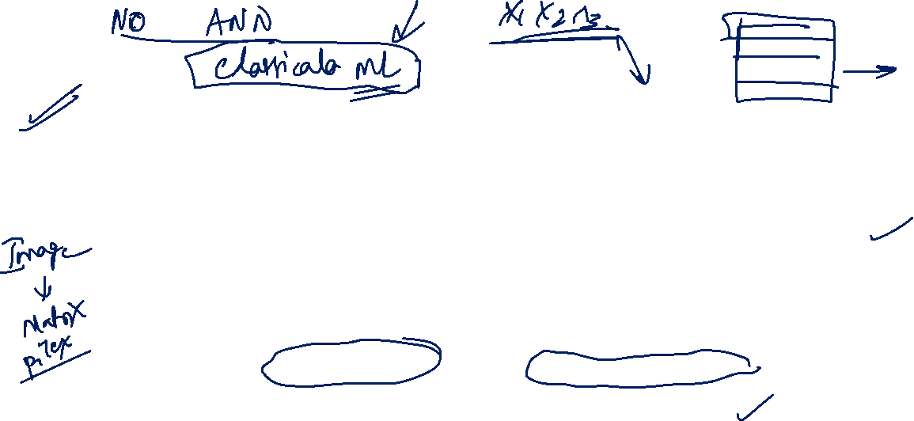
ML and DL- Few more differences
Machine learning
Deep learning
the algorithms that can “think” and provide an answer or decision
they only explore data based on programmed data feature extraction; that is, they only look at data in the way we programmed them to do so
No notion of artificial neurons in classical ML techniques
the class of algorithms that can learn on their own — the “deep learning” algorithms
When exposed to different situations or patterns of data,
these algorithms adapt.
they can adapt on their own
uncovering features in data that we never specifically programmed them to find,
Hence we say that they learn on their own.
Artificial neurons are integral part and building blocks of DL

Slide 15
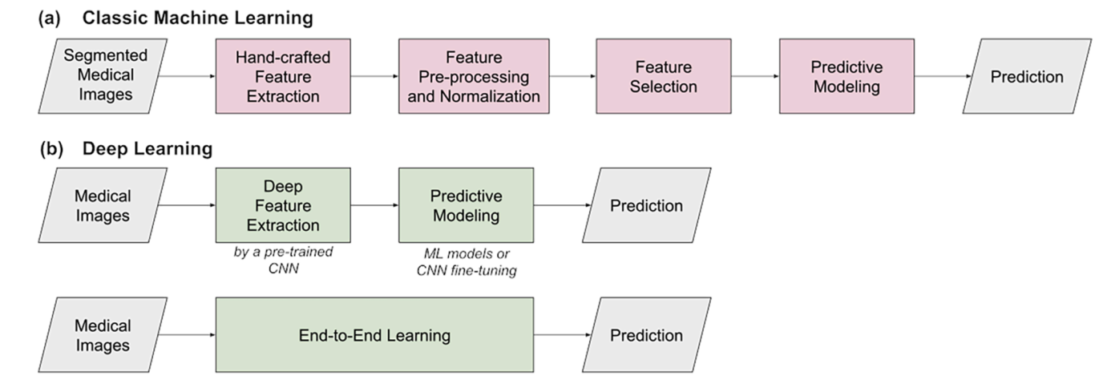
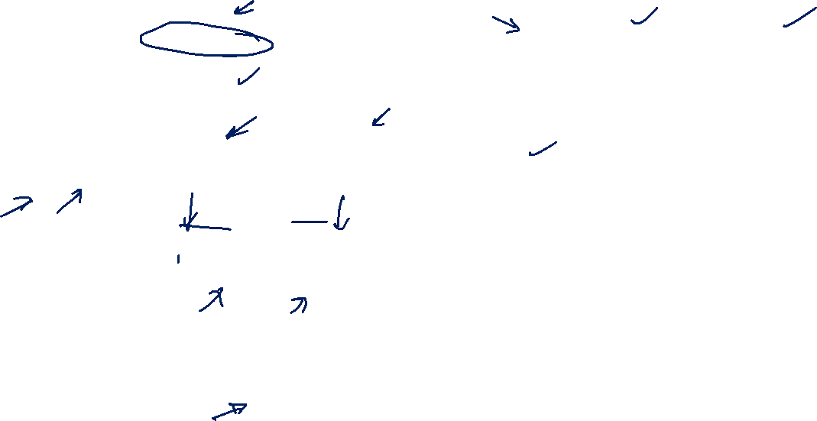
Example: ML and DL distinction
Typical architecture and workflow of artificial intelligence systems for predictive modelling: a) classic machine learning, with the various processing steps involving hand-crafted features; b) deep learning considering either deep medical image feature extraction or end-to-end learning.
AI applications to medical images: From machine learning to deep learning

Slide 16
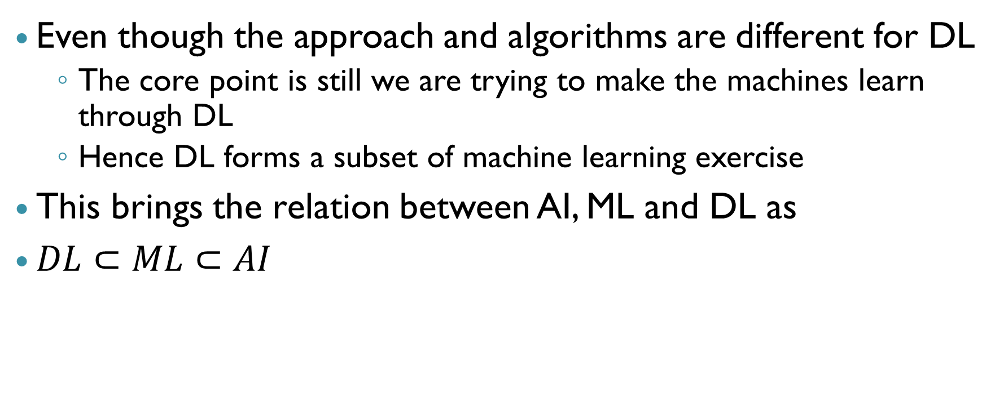

DL as a subset of ML
Even though the approach and algorithms are different for DL
The core point is still we are trying to make the machines learn through DL
Hence DL forms a subset of machine learning exercise
This brings the relation between AI, ML and DL as
$DL⊂ML⊂AI$

Slide 17

AI, ML and DL-Relation
Pictorially, the relation obtained in previous slide is as follows
Artificial intelligence
Machine learning
Deep learning

Slide 18
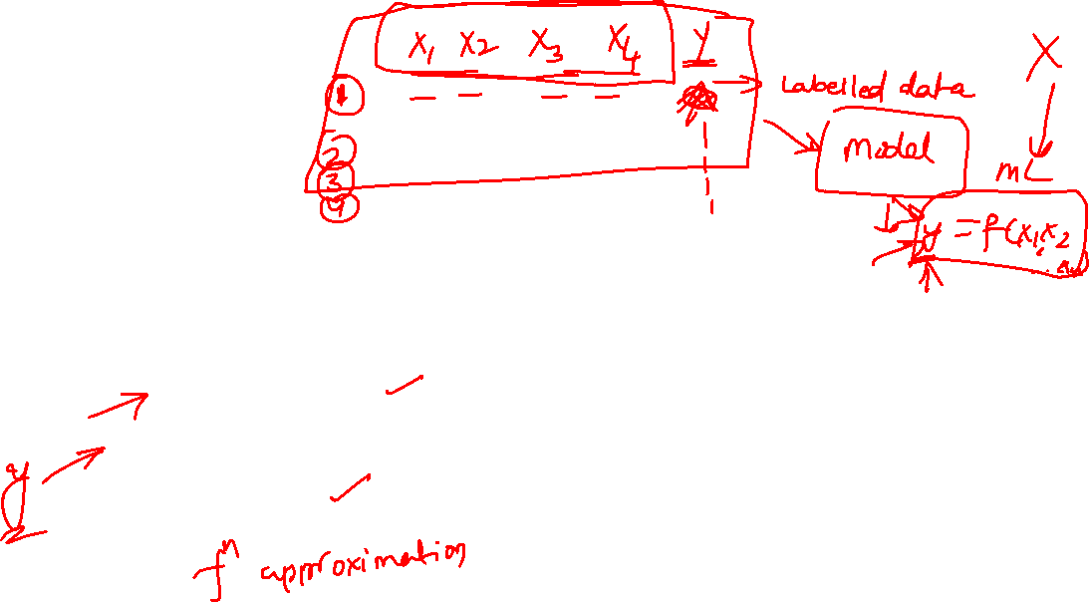
Predictive analytics
Predictive analytics deals with
Building models for prediction of either
qualitative variable (s) (Classification problems) or
quantitative variable(s) (Regression problems)
The model building part of the workflow of data analytics is dealt by
predictive analytics

Slide 19
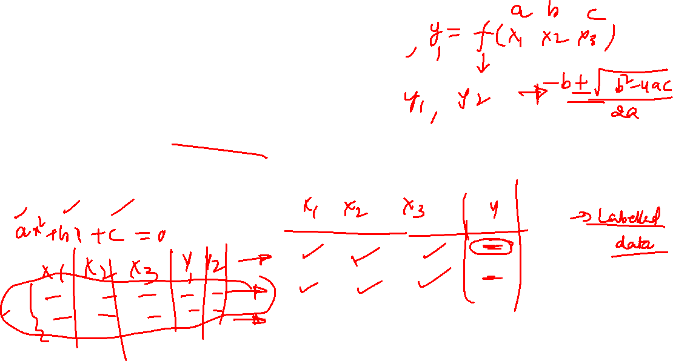
Models can built using
Classical ML techniques or
Deep learning techniques
Supervised learning approach is mostly used for predictive analytics

Slide 20
Why is ML needed?
Large amount of data
Organisations will try to explore if any insights that help the business
Automated insights
New data added continuously
Algorithms work on the background to build the relevant models

Slide 21
Types of ML
Machine learning
Supervised
Unsupervised

Slide 22
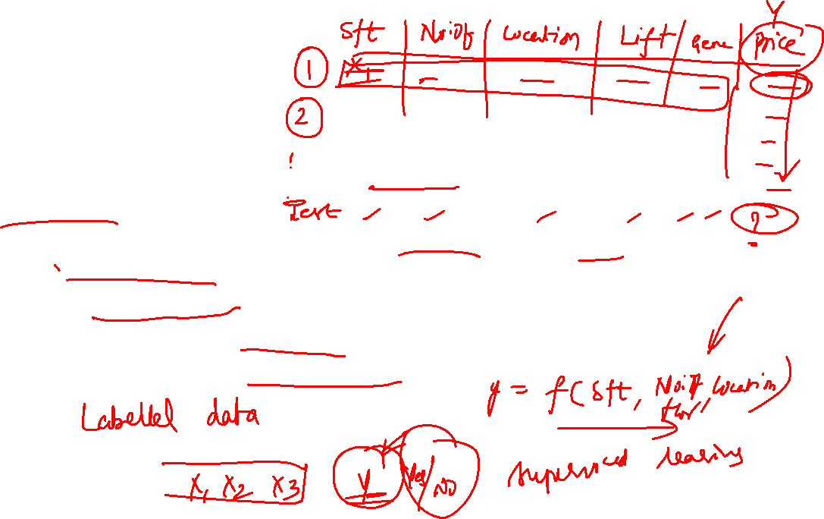
Supervised learning
Supervised Learning
Machine Learning is like having a supervisor while a machine learns to carry out tasks.
In the process, we basically train the machine with some data that is already labelled correctly.
Post this, some new sets of data are given to the machine, expecting it to generate the correct outcome based on its previous analysis of the labelled data.

Slide 23
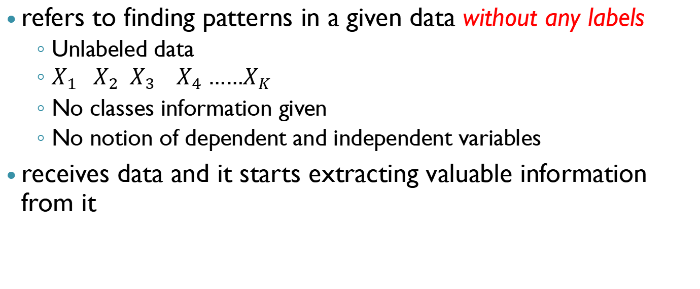
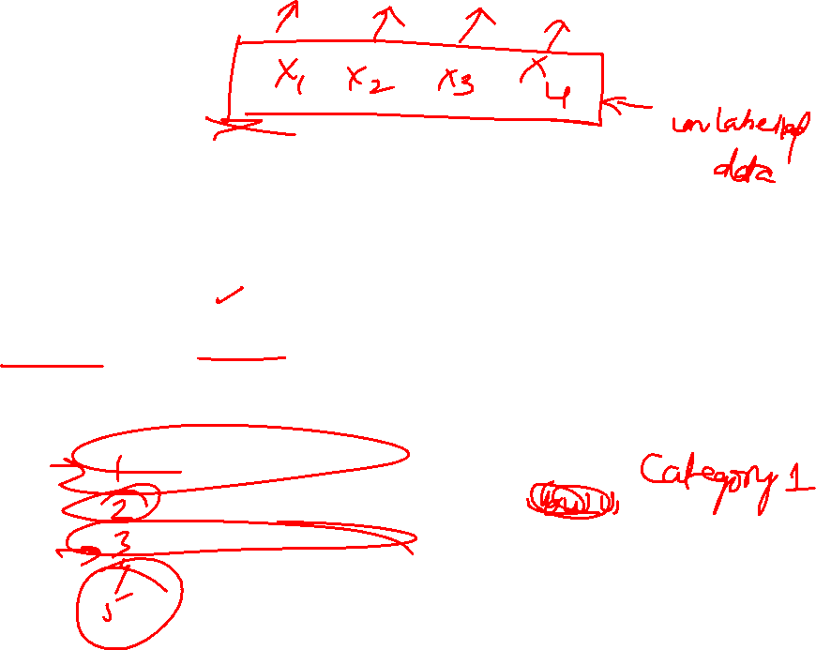
Unsupervised learning
refers to finding patterns in a given data without any labels
Unlabeled data
$X_{1} X_{2} X_{3} X_{4} ……X_{K}$
No classes information given
No notion of dependent and independent variables
receives data and it starts extracting valuable information from it

Slide 24
Disadvantages compared to Supervised learning
Not suited for predictive analytics
No notion of model
Difficult to check the performance of the algorithms
Difficult to verify if the algorithm has learned something from the data or not
No idea what the correct output should be
Every time user has to look into the solution
analyse whether the algorithm has done something useful or not

Slide 25
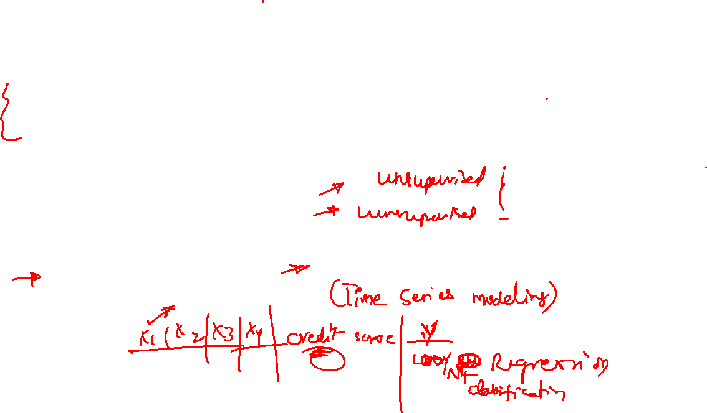
Use cases
Health
Diagnostics
Retail
Recommender systems
Market basket analysis
Financial
Stock market auto trading
Banking

Slide 26
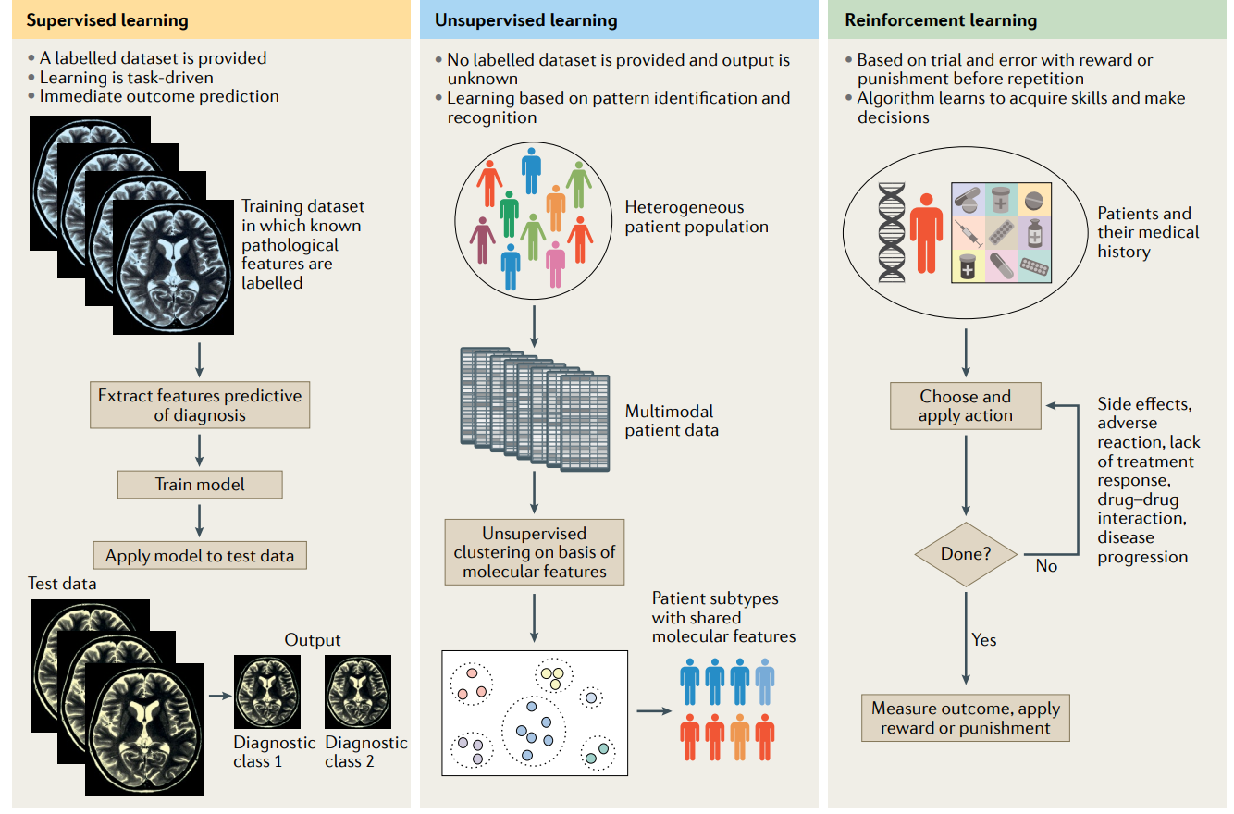
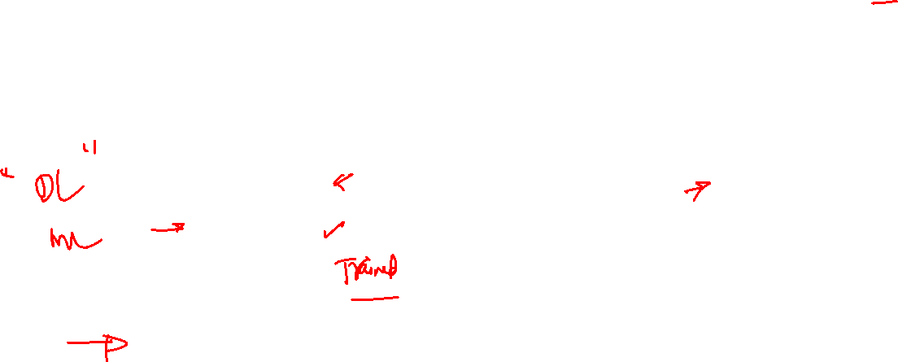
Health

Slide 27
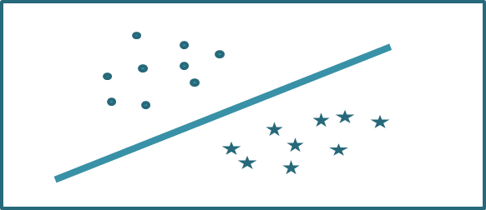
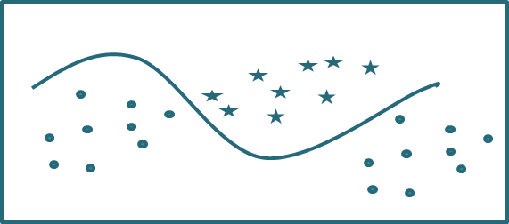

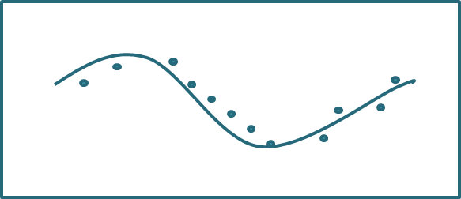
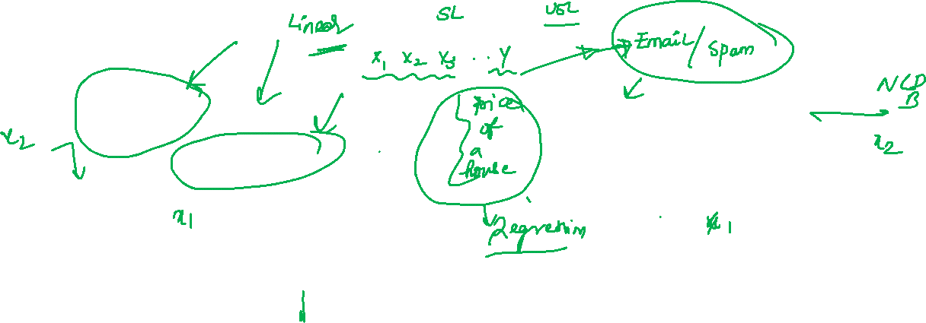
What major problems does ML solve for decision-making?
Classification problems
Function approximation or Regression problems
11

Slide 28
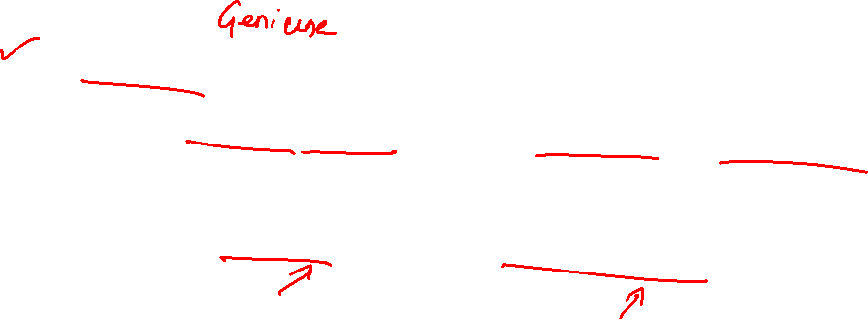
Machine learning – Classification problems
Fraud detection in credit card transactions
Identifying whether an email is a spam or genuine
Distinguishing between different products in retail store shelf
Detecting defective and non-defective items

Slide 29

Machine learning – prediction problems
Predicting materials property for different molecular structures
Predicting scores in a cricket match
Predicting reaction kinetic parameters in biochemical reactions
Predicting the value of a board position in a game of chess

Slide 30
Machine tearning techniques : type & prevalent use
Linear regression - function approximation
Logistics regression - classification
K-nearest-neighbour – classification & function approximation
K-means clustering – Unsupervised learning clustering
Linear discriminant analysis (LDA) - classification
Support vector machines - classification
Decision trees and random forests - classification & function approximation
13

Slide 31

Machine learning techniques : type & prevalent use
Principal component analysis - function approximation
Quadratic discriminant analysis (QDA) – classification
Naïve Bayes classifier - classification
Hierarchical clustering - classification
Neural networks – classification & function approximation
14

Slide 32

Knowledge required
Foundational
Probability and Statistics
Linear algebra
Optimization
Programming, Databases, Data Structures
Programming environments
Python
R
Specialization
Machine learning, Reinforcement learning
Neural Networks
Natural language processing
Image processing and Computer Vision
Time Series Analysis

Slide 33

THANK YOU

Slide 34
What is AI?
Mimicking human intelligence
Could include many aspects of intelligence
Leaps of insight, tacit knowledge, emergence, consciousness, meta-cognition – awareness of one’s own thought process
Key Features
Representation, Reasoning and Decision Making
Very difficult to realize in its most expansive conceptualization
What we see now is more applied (narrow) AI
15

Slide 35


AI – is it new or what has changed ?
Computing in 1985*
Cray-2 supercomputer
1.9 GFLOPS
150 kW!
$40 Million!
Computing in 2015
3 GFLOPS
1 W
$300
Re-enter AI
Algorithms for deriving useful information about state
of the system (engineered, social, biological)
All-weather algorithms for all kinds of problems
Self-learning
Industry 4.0 + DS
Benchmarks
Transfer learning
Uncover patterns
Power of information
16

Slide 36
What is Big Data?
Large amounts of data
Size of data is so huge that traditional data management tools are unable to store, manage and process the data
Pillar behind the idea that one can make useful inference with a large body of data that wasn’t possible before with smaller datasets
Extremely large datasets can be analyzed computationally to reveal patterns, trends, and associations that are not transparent or easy to identify otherwise

Slide 37

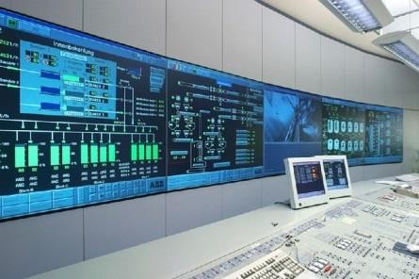

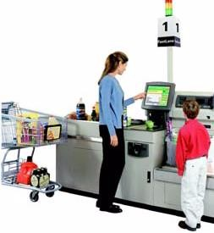
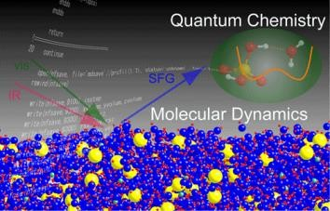
Big Data is Everywhere!
Enormous amounts of data are being collected and stored
Web data, e-commerce
Point-of-sale at stores
Bank transactions
Social Network
Real-time plant data
Materials Formulation & Design
Molecular Simulations

Slide 38

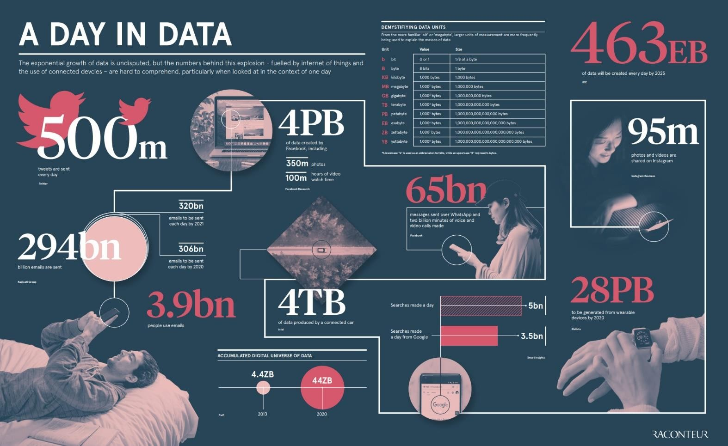
How much data is Big Data?
https://www.raconteur.net/infographics/a-day-in-data

Slide 39

Characteristics of Big Data- IBM 4 Vs
Variety
Velocity
?
Veracity
Volume

Slide 40
Career Prospects
Data Engineering (Organizing data, storage, retrieval, cleaning, organization) – Databases, visualization, tools
Data analysts or scientists (Analyzing data and deriving insights)
Quantitative analysts (building models): Marketing, manufacturing
Image processing: Retail, Transportation, Manufacturing, Security, Health
Natural Language processing : Marketing and advertising (chat-bots), personal assistants (connected cars), customer service, R&D (searching documents)
Product developers : deploying the solution: in-house, web, cloud

